Slide 1
M&A during COVId19
Equation angels

Slide 2
Discussion Agenda
Deal activity levels
Cash matters
Addressing valuation challenges
Due diligence implications
Cross border considerations
Distressed deals

Slide 3
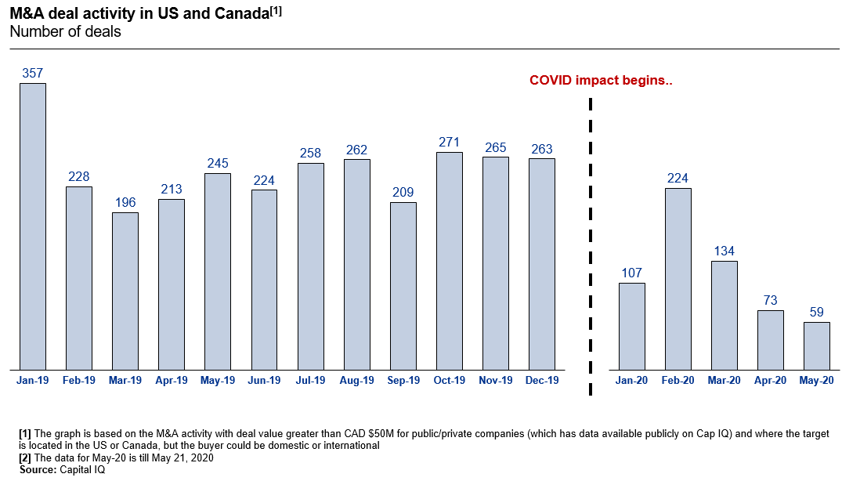
Deal Activity levels
Canadian deals were on a tear
COVID19 has slowed but not terminated the M&A markets

Slide 4
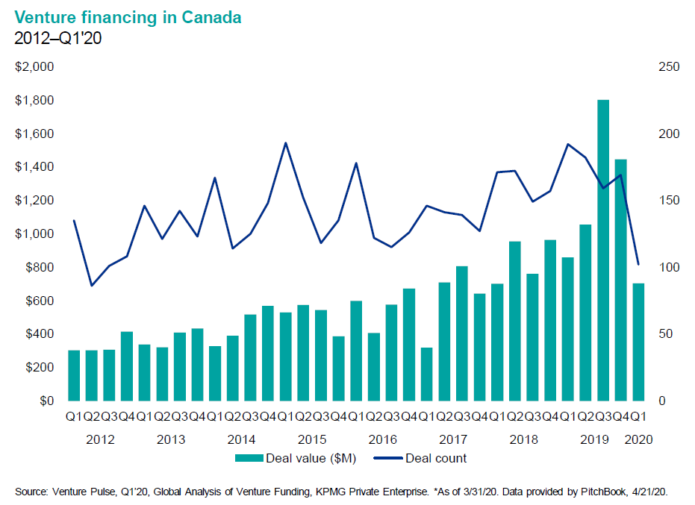
Deal Activity levels (cont’d)
Similarly venture transactions and values were record highs in 2019, but the brakes have been applied.

Slide 5
Cash matters
In this phase of the cycle: cash will be king on deals
If deeply distressed, cash may be required immediately and lent to the target in advance of the equity closing.
Prepare your own cash flow projections : do you need capital for your own business? Are your stakeholders willing to provide more at an increasing valuation?
Alternative deal structures may be all shares (i.e. true mergers)

Slide 6
Addressing valuation challenges
Earnouts
Staged closings – phases or deferrals
Convertibles (preferreds or debt)
Warrants
Escrows

Slide 7
Due diligence implications
Difficulty Completing Due Diligence
Physical access to facilities, equipment, employees limited
Employee assistance in populating datarooms
Accessing records located on site
Delay in third party responses

Slide 8
Due diligence implications (cont’d)
COVID-19 Specific Due Diligence Matters
Additional reviews in respect of compliance with COVID-19 laws & regulations
Consider how & what government programs have been accessed
Employee impacts
Ongoing health and safety requirements
Existing or prior diagnosis and implications
Constructive dismissal claims
Remote working contingencies

Slide 9
Due diligence implications (cont’d)
Financials - March / April / May 2020 might be excluded from all analysis
Customer and vendor resiliency
Pension plan liability
Supply chain issues
Contract management – force majeure issues
Real property leases – space reduction opportunities
Insurance – available to respond COVID 19 claims
Debt – COVID 19 related defaults
Regulatory obligations re: COVID 19 reporting
Post closing integration planning

Slide 10
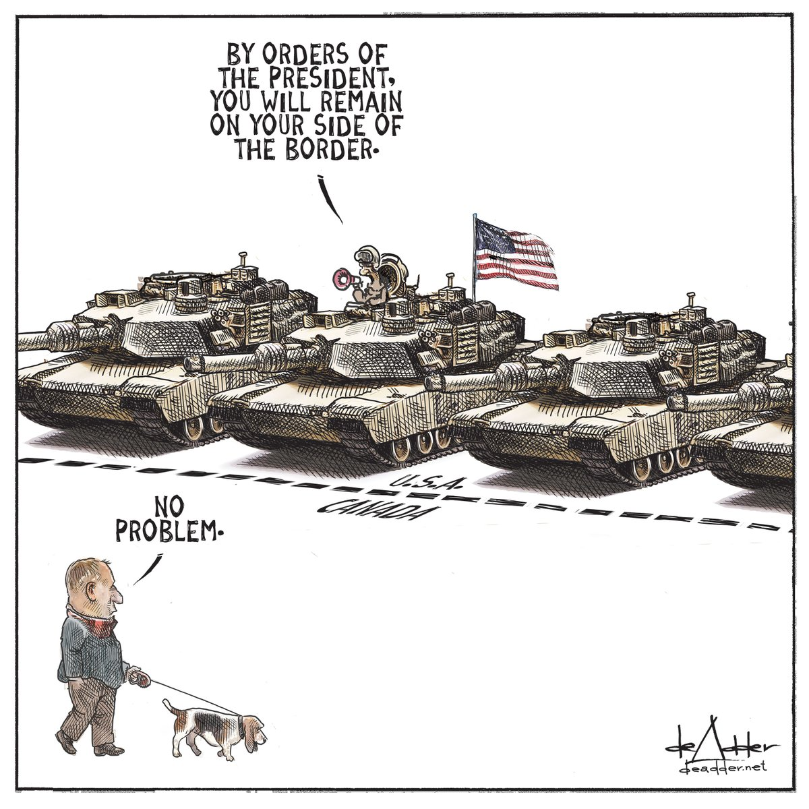
Cross border considerations
Transactions are moving slowly due to inability to travel to target locations
Virtual diligence has expanded beyond just datarooms
Provincial boundaries and corporate travel policies are inhibiting meeting

Slide 11
Distressed situations
Why is the target distressed?
Temporary or permanent?
Internal vs. external factors?
What is the cash burn rate?
Synergies?
Strategic value? – Acquihire vs. products / market
Realistic vendors / stakeholders
Diligence will necessarily need to be quick but thorough
Availability of tax losses?

